Slide 1

S.E.E.D. Ministry
2018 Summary

Slide 2
241 families &
479 retreatants
Served in the past 3 years

Slide 3
From 6 to 16 leaders
Who have served as part of SEED Source Team, in the past 3 years

Slide 4
125 leaders
36/125 leaders
56/125 leaders
Trained and active throughout the ministry
Who were previously SEED retreatants
are active in DH groups

Slide 5
Fruits & Graces

Slide 6
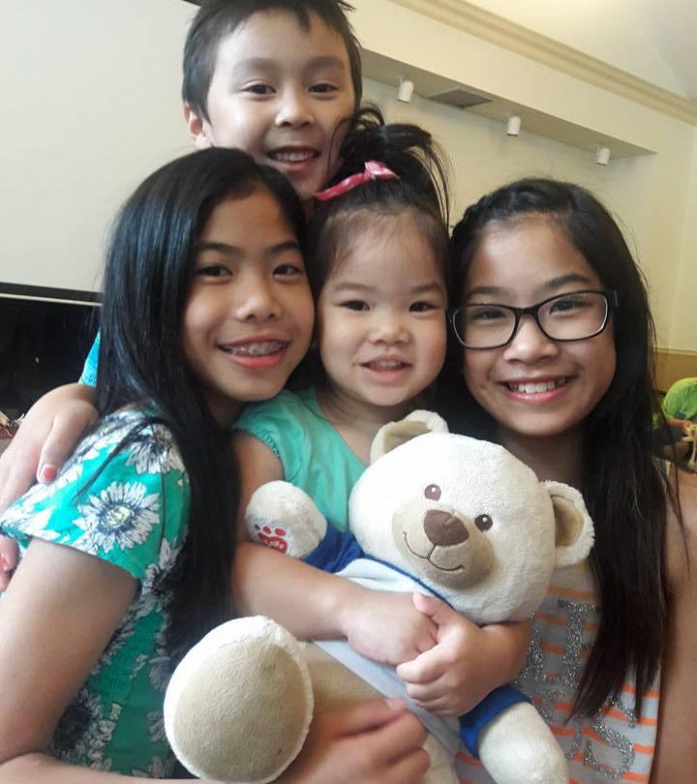
SEED Source
Retreats
Growth of Retreatants
Notes:
Organizer training has led to growing support systems for many centers.
Source Team has grown in membership and experience
Preteen Track for all SEED Centers, and growing number of centers in the Southwest Region.
There is visible growth in spirituality and maturity of retreatants. They become more caring, more active, discerning Catholics.
Better prepared for young adult retreats.

Slide 7
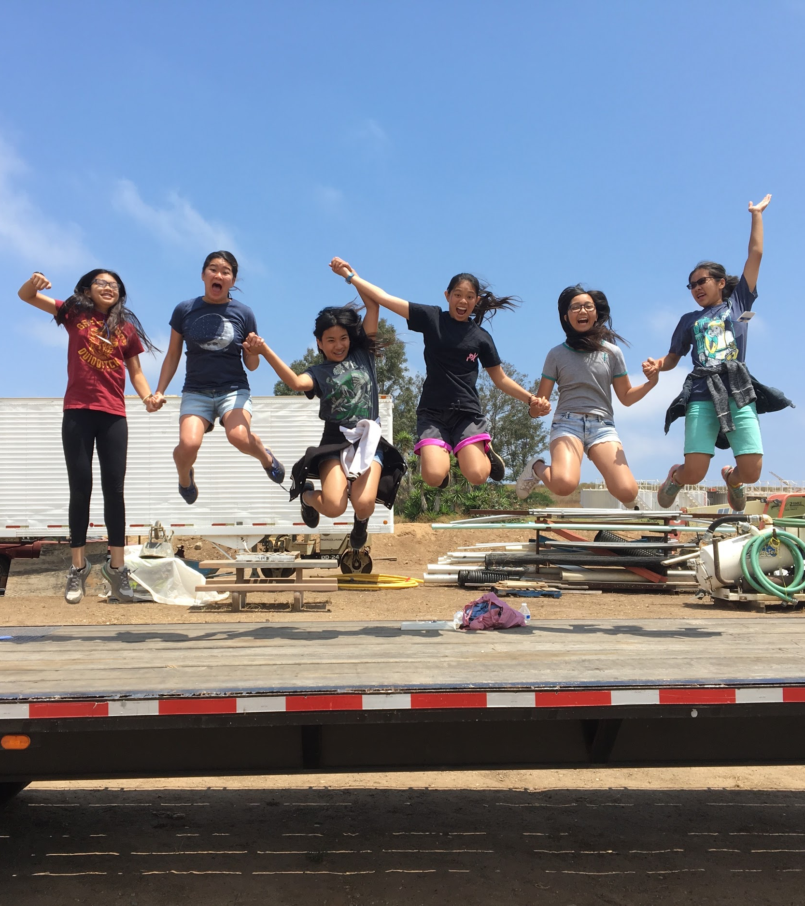
Community Life
Serving the Church
Notes:
Increased participation in DH events due to involvement in SEED.
Children and young adults go home and form prayer groups.
New families welcomed from outside DH.
Retreatants proudly share their experiences with other kids.

Slide 8
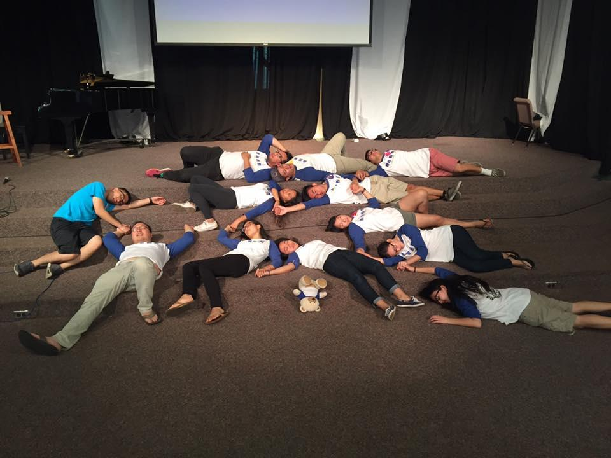
Challenges & Needs

Slide 9
Need for deepening
Limited resources
Lack of Manpower
Notes:
As the children attend from year to year, their desire for new and deeper experiences grows.
Available sites, affordable costs, scheduling difficulties, heavy costs for families.
Limited resources to support formation of SEED Leaders.
Manpower is a challenge on every level of the ministry. Leaders, organizers, people to help with parent track.

Slide 10
Dong Hanh Resources
Unclear Relationship with CLC-USA
Notes:
We do not have enough groups to respond to the families and individuals desiring to join a small group.
We are still figuring out the best way to connect to and serve the larger community of CLC-USA.

Slide 11
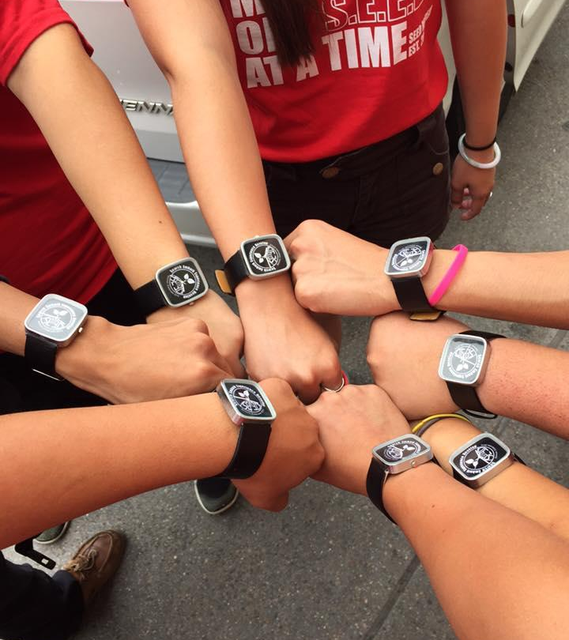
NEEDS
Financial aid and formation opportunities for leaders.
Mentorship & Prayers.
More man and woman power!
Collaboration with Regional and National BPV, & other ministries

Slide 12
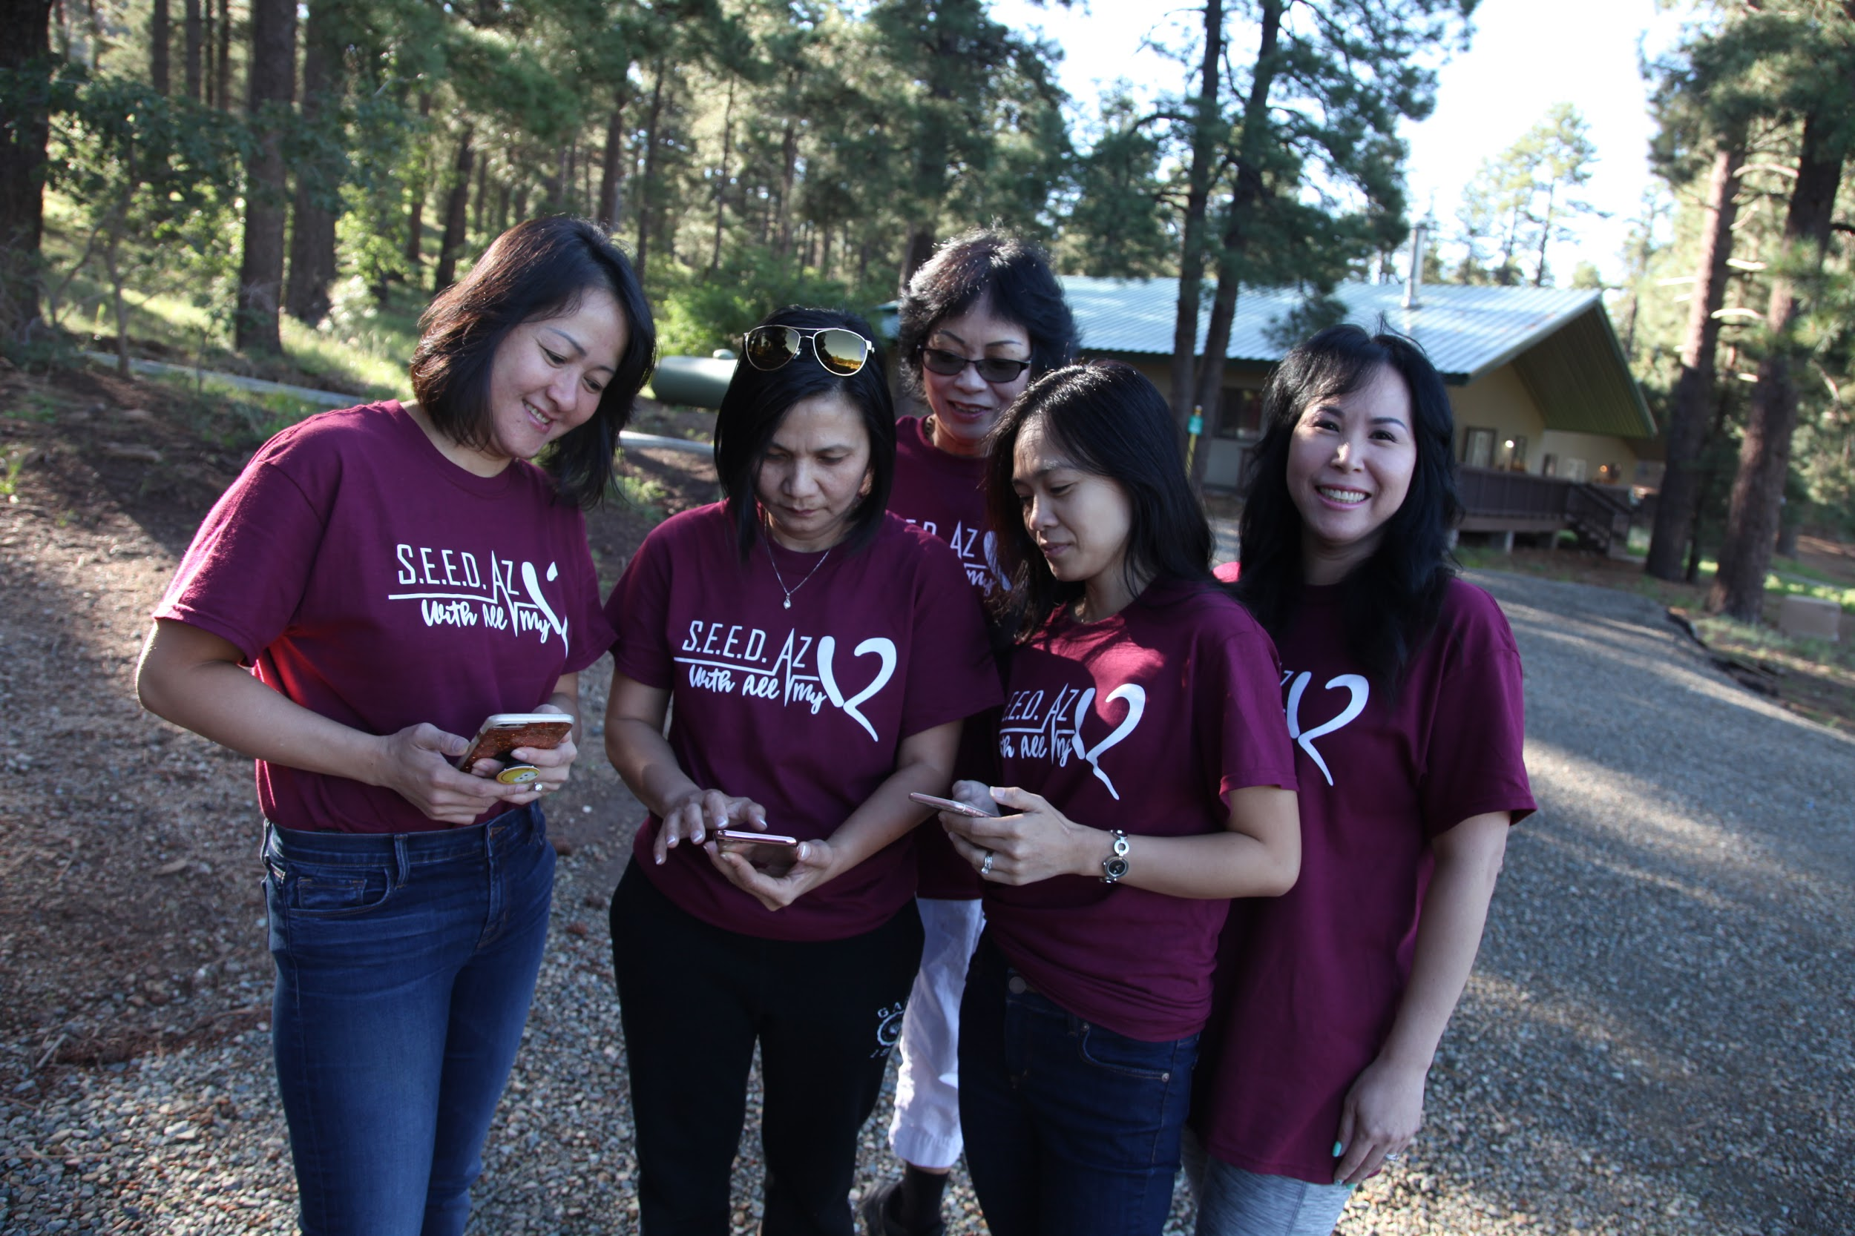
News &
Upcoming Events

Slide 13
2018 S.E.E.D. EVENTS
June 22 - 24
SEED Dallas IX
SEED NorCal IV
July 5 - 8
SEED Northeast IX
August 3 - 5
SEED Arizona XIII
June 29 - July 1
SEED Denver V
SEED SoCal VIII A
July 20 - 22
SEED SoCal VIII B
Dec 2018
SEED Summit III

Slide 14
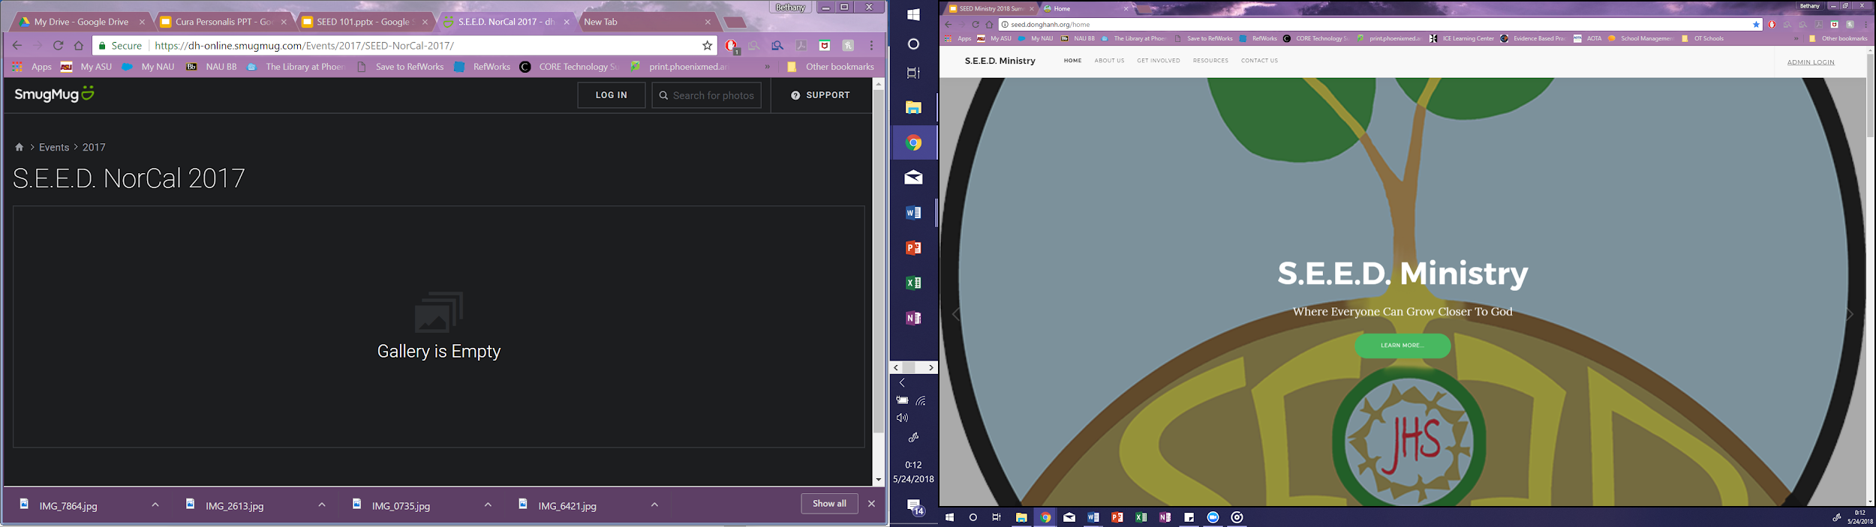
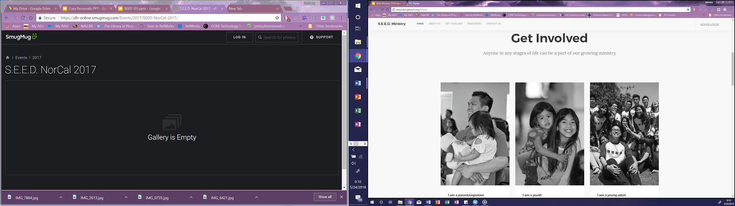
S.E.E.D. WEBSITE

Slide 15
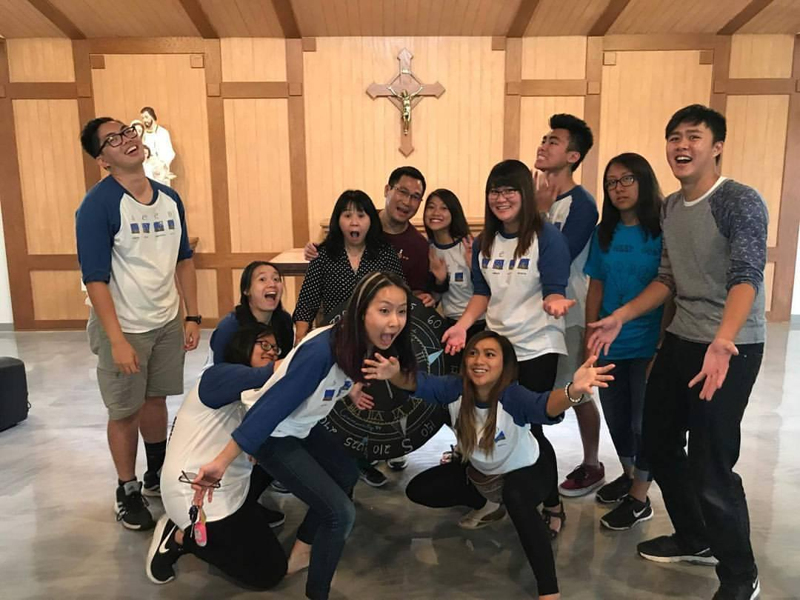
The gift of CLC unfolded in S.E.E.D.

Slide 16
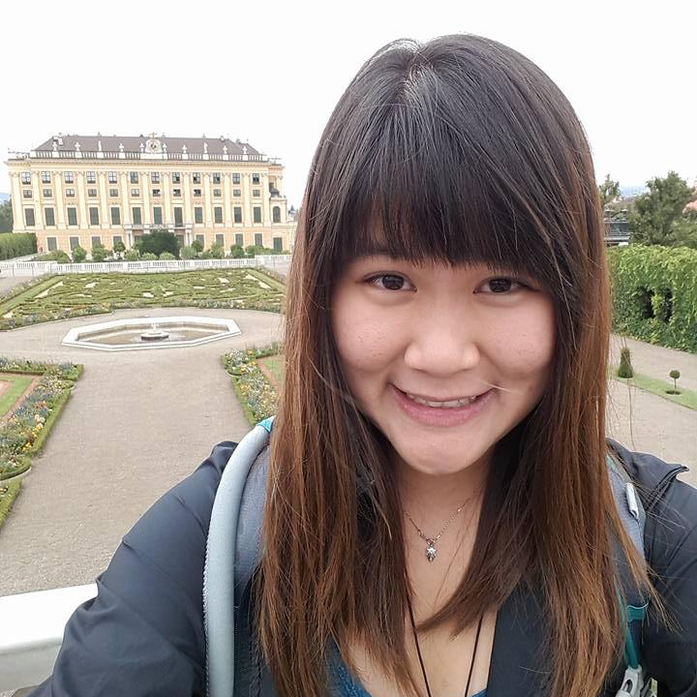
Thank you
On behalf of the ministry ~
Thank you for your tireless love & support for S.E.E.D.
Bethany Thao-Vy Vu
S.E.E.D. National Chair

